Slide 1
Medallion Architecture

Slide 2
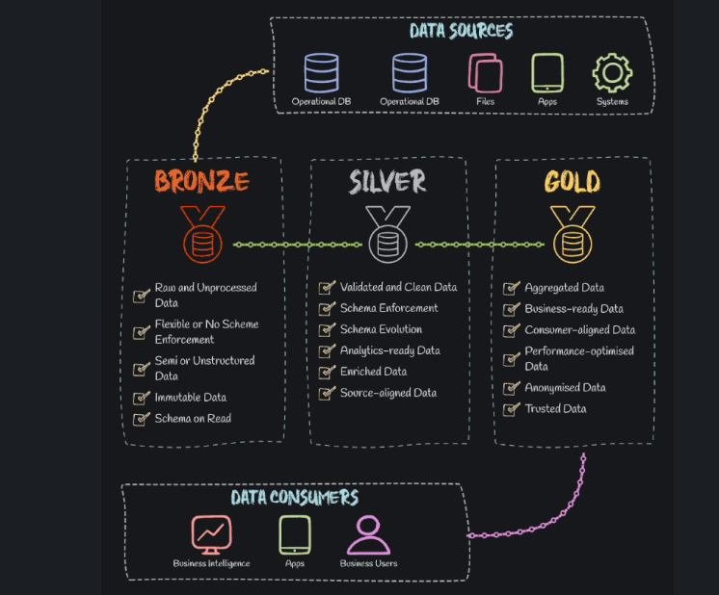

Slide 3
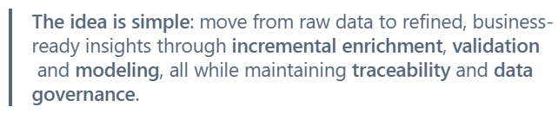
What Is Medallion Architecture?
Medallion Architecture is a layered data design paradigm commonly used in modern data platforms such as Databricks, Snowflake, and Azure Synapse. It organizes data across three progressive layers - Bronze, Silver and Gold - each representing a step forward in data quality, usability and business relevance.
This structured approach not only supports modular development but also ensures auditability, reusability and scalability across analytical workloads.

Slide 4
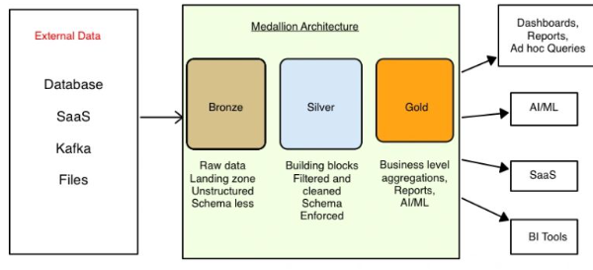
✨️Medallion architecture, a data design pattern, strategically organizes data into distinct layers (Bronze, Silver, and Gold) to enhance its quality and structure incrementally within a data pipeline. This method is widely adopted in constructing a lakehouse architecture, combining the storage benefits of a data lake with the management functionalities akin to a data warehouse

Slide 5
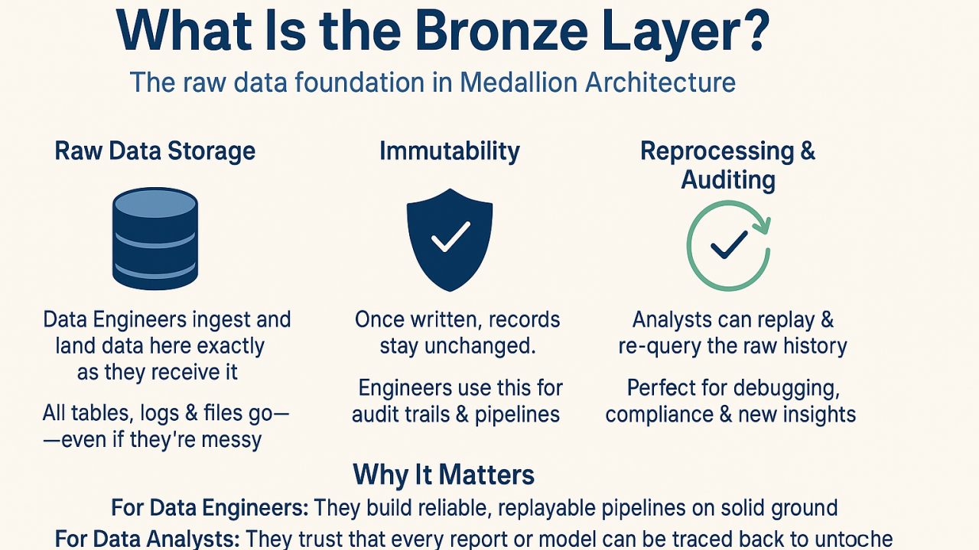

Slide 6
Bronze Layer – Raw Data Ingestion
The Bronze Layer is the foundation of the Medallion Architecture. It focuses on capturing raw, unaltered data from diverse sources including:
Operational systems (CRM, ERP, LOB apps)
Streaming services (Kafka, IoT feeds)
Batch files (CSV, JSON, XML)
Raw Ingestion Stores unfiltered data from various sources like APIs, logs, IoT streams, or files. It acts as the single source of truth, retaining full fidelity.
Databricks: Stored as Delta Lake tables
Key Characteristics:
Stores data as-is without transformations.
Designed for traceability, auditing and historical replay.
Often includes full snapshots with truncate-and-insert or append-only mechanisms.
Why It Matters:
This layer ensures that no information is lost and provides a single source of truth in its rawest form - essential for compliance, root-cause analysis, and debugging.

Slide 7
Silver Layer – Cleansed and Standardized Data
This layer is all about data refinement.
Clean & Modeled Data is cleaned, deduplicated, joined, and structured to reflect business logic. It’s the query-ready, analytics-friendly version.
Operations Typically Performed:
Data Cleaning (remove duplicates, handle nulls)
Standardization (unify formats and naming conventions)
Normalization (reshape data for consistency)
Deriving New Columns (e.g., time buckets, categorization)
Data Enrichment (adding reference data or external attributes)
Light Business Logic (validations and filters)
Databricks: Refined using notebooks, Delta Live Tables

Slide 8
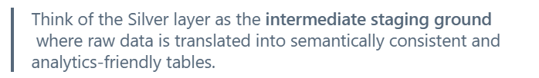
Silver Layer – Cleansed and Standardized Data
Primary Objective:
Prepare the data for analysis in a clean, consistent, and reliable format - allowing data analysts and engineers to work with trusted data without diving into the raw source complexity.

Slide 9
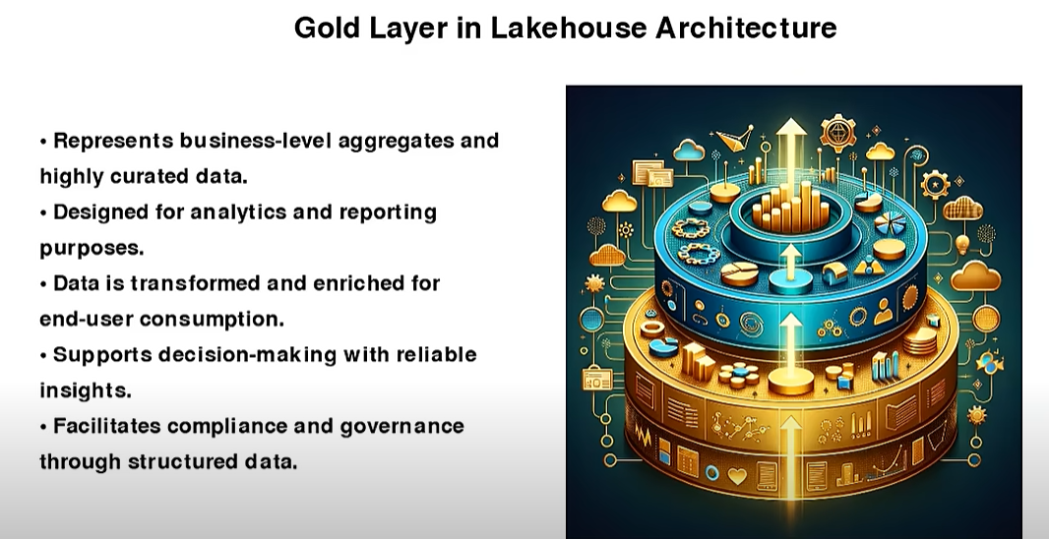

Slide 10
Gold Layer – Business-Level Aggregations and Insights
The Gold Layer is the most refined level of the Medallion Architecture. It contains business-curated data that is purpose-built for analytics, reporting, and decision-making.
Operations in the Gold Layer:
Data Integration (merge data across domains)
Aggregations (summarizations by time, region, customer, etc.)
Complex Business Logic (KPI calculations, rules-based transformations)
Modeling (star schemas, flat wide tables)

Slide 11
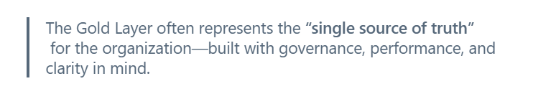
Gold Layer – Business-Level Aggregations and Insights
Business-Ready Insights This is the layer where decisions are made. Aggregated and curated data powers dashboards, machine learning models, and executive reports.
Used For:
Executive dashboards and BI tools
KPI tracking and operational reports
Self-service analytics for business users
Machine learning feature stores (in some cases)
Databricks: Feeds ML workflows, Power BI, etc.

Slide 12
Visual Summary of the Medallion Layers
Bronze Layer – Raw ingestion from multiple sources
Silver Layer – Cleansed and validated data
Gold Layer – Aggregated, curated data for business use
With each layer, data quality, usability, and trust increase.

Slide 13
🔥 Tech stack examples:
⫸ Bronze Layer (Raw): Azure Data Lake Storage, Amazon S3, Delta Lake ⫸ Silver Layer (Cleaned & Structured): Apache Spark, dbt, Azure Data Factory ⫸ Gold Layer (Business-Ready): Power BI, Tableau, Looker, Databricks SQL

Slide 14
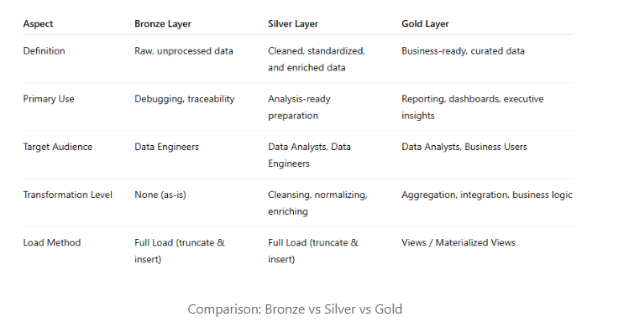
Comparison: Bronze vs Silver vs Gold

Slide 15
Benefits of Medallion Architecture

Slide 16
Technical Benefits:
Separation of Concerns: Modular layers support easier debugging and development.
Improved Data Lineage: Trace any error or inconsistency back to the original source.
Incremental and Streaming Support: Suitable for batch, micro-batch, and streaming architectures.
Reusability: Layers can serve multiple downstream use cases without redundant processing.

Slide 17
Business Benefits:
Data Trust: Each layer adds validation and structure, increasing confidence in data quality.
Faster Time-to-Insight: Analysts get clean data faster without reprocessing.
Governance & Compliance: Audit trails and raw data retention support compliance needs.
Scalability: Easily expand to accommodate new sources, domains, and workloads.

Slide 18
Where Is Medallion Architecture Used?
Databricks Delta Lake – native support for layered Delta tables
Azure Synapse Analytics – supports lakehouse patterns with SQL and Spark
Snowflake – layering via virtual warehouses and data marts
Apache Iceberg / Hudi – evolving support for medallion-like modularization
Industries such as finance, healthcare, retail, and logistics use Medallion Architecture to power their real-time dashboards, regulatory reporting, machine learning models, and more.

Slide 19
💼 Why it matters: ✅ Enables scalable and reliable data pipelines ✅ Simplifies data quality management ✅ Enhances governance and security ✅ Supports real-time and batch processing ✅ Aligns technical design with business goals

Slide 20
CROSS LAYER CONSIDERATIONS

Slide 21
1. Data Flow and Transformation
2. Data Governance and Quality
3. Performance Optimization
4. Operational and Cost Considerations
5. Cross-Layer Integration with Data Mesh and Other Paradigms
6. Challenges and Trade-offs

Slide 22
1. Data Flow and Transformation
Incremental Refinement Across Layers
Schema Evolution:

Slide 23
2. Data Governance and Quality
Data Quality Checks
Access Control and Security
Compliance and Auditing

Slide 24
3. Performance Optimization
Storage and File Format:
Query Optimization
Streaming vs. Batch:

Slide 25
4. Operational and Cost Considerations
Pipeline Orchestration
Cost Management

Slide 26
5. Cross-Layer Integration with Data Mesh and Other Paradigms
Data Mesh Compatibility
Integration with External Tools

Slide 27
6. Challenges and Trade-offs
Increased Storage Costs: Storing data in multiple layers can triple storage needs, especially for large datasets.
Consumer Burden: Downstream users may need to create additional ETL jobs to access data, leading to tight coupling with source models.
Complexity at Scale: Managing dependencies and performance across layers requires expertise and robust tooling.
Consideration: Evaluate whether a full Medallion architecture is necessary for your use case. For smaller organizations, a simplified two-layer approach or hybrid lake/warehouse model may suffice.

Slide 28
7. Best Practices for Cross-Layer Implementation
Use Delta Lake: Leverage Delta Lake’s ACID transactions, time travel, and schema evolution across all layers for reliability and flexibility.
Centralize Governance: Use Unity Catalog for consistent governance, access control, and lineage tracking.
Automate Pipelines: Use DLT or Workflows to streamline data flow and reduce manual intervention.
Monitor and Optimize: Implement monitoring for pipeline health and optimize tables (e.g., Z-Ordering, partitioning) based on query patterns.
Balance Latency and Quality: For real-time use cases, prioritize streaming pipelines but maintain normalized models in Silver to avoid long-term maintenance issues.
Adapt to Needs: Customize the architecture based on data volume, velocity, and analytical requirements, avoiding rigid adherence to the Bronze-Silver-Gold model.

